Slide 1
Addressing operational challenges in Named Data Networking through NDNS distributed database
PhD thesis defense
Alexander Afanasyev
alexander.afanasyev@ucla.edu
Wednesday, September 18th, 2013

Slide 2
Research problem
Named Data Networking (NDN) uses pure data-centric communication model
  solves many outstanding problems with current communication patterns
    build-in multicast
    privacy and security
Deployment of the architecture faces a number of operational challenges, including
  management of security credentials
  authorization of routing resources (namespace regulation)
  named-based routing scalability

Slide 3
Research objective
Design a universal, scalable, secure, and easy to use distributed database system for NDN, leveraging all advantages of NDN
  borrow from DNS that has been working well enough over last 25 years
Use it to support solutions of operational problems in the architecture
  security credential management
  scalability of name-based NDN routing
  regulate NDN namespace
  other solutions to come
Notes:
DNS has been successful example of highly scalable, powerful, and universal database system for the existing IP-based Internet

Slide 4
Outline
Part 1: NDNS – scalable, distributed, and general-purpose database for NDN
  NDN overview
  design
  security
  evaluation
Part 2: Applying NDNS to address operational challenges
  security credential management
  scalability of name-based NDN routing

Slide 5
NDNS scalable distributed general-use database for NDN
Part 1

Slide 6

NDN overview: basics
Two types of packets
  Interest packet
    name
    nonce
    optional selectors
  Data packet
    name
    content
    signature
Names defined by applications
  /net/ndnsim/www/index.html/...
Interest packet
Name
Selectors (opt)
Nonce
Data packet
Name
Content
Signature

Slide 7



NDN overview
NDN separates
  objective of retrieving
  specifics of how to do it
Interest names exactly what to fetch
  matching (secured) Data is retrieved by the network
  from caches, in-network storage, or data producers
Caches
Interest
In-network storage
Data
Notes:
Interests should uniquely identify the requested Data

Slide 8
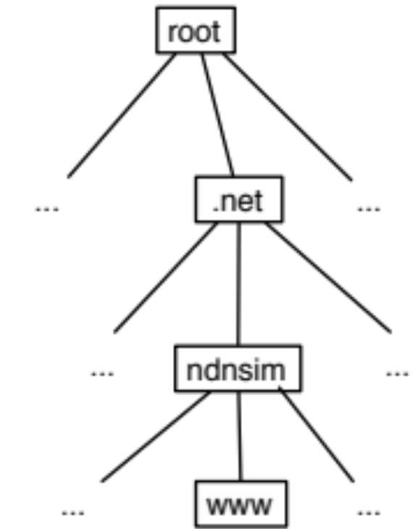
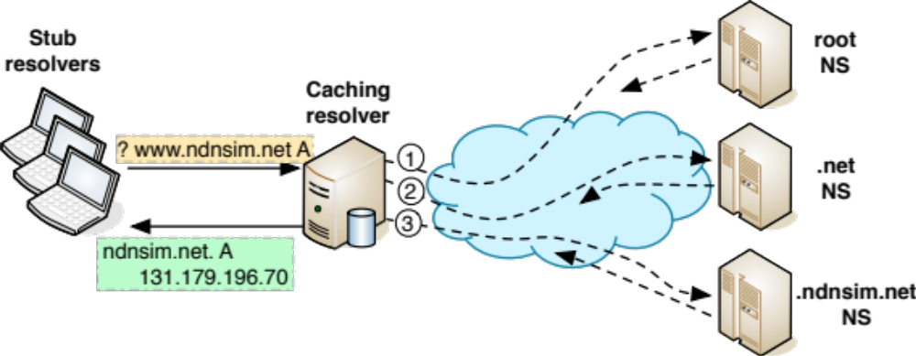
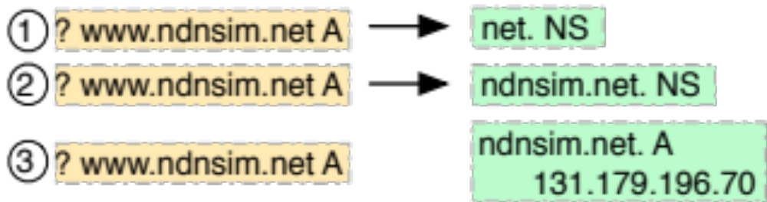
DNS overview
DNS is data-centric (data query, data reply), but on application layer only
  DNS design based on on IP’s point-to-point packet delivery
Caching resolver navigates through hierarchy distributed DNS authority servers to find one who can answer the query
  figuring out exactly which server to ask
  exactly the same questions
Notes:
explain what it means: rerturning NS RRset

Slide 9
DNS → NDNS: What don’t need changes?
DNS name space and the name space governance
DNS’s application-level data-centricity matches directly to NDN’s Interest-Data exchange
The roles of
  authority server (provided by name owners)
  caching resolver (provided by ISP or service provider)
  stub resolver (inside end nodes)

Slide 10
NDNS namespace considerations
NDN has no restrictions on Data names
As a design goal, NDNS uses DNS-compatible names
  DNS already defines a strict hierarchy and name delegation from TLD, SLDs, etc.
  NDNS do not introduce new naming, rather than taking the existing names and move them into NDN world
    re-using well-established governance (ICANN, IANA, registrars)

Slide 11
DNS → NDNS: What needs to be changed?
Data unit and zone management
  DNS uses different data units at different levels:
    DNS message (network)
    RR set (resolver app)
    DNS zone file (name server app)
  NDNS uses Data packets at all levels
Iterative query
  NDN Interest cannot be answered with non-explicitly asked data
    Interest and Data should match
  need to navigate hierarchy without relying on p2p connections
  utilize both network- (routers) and application-level (caching resolver) caches
Recursive query
  no need for discovery of local caching resolver
Security
  NDN has build-in security for Data fetching
Mechanism for dynamic zone updates
Notes:
navigating down to the final answer by asking the right question, instead of reaching the right server
----- Meeting Notes (9/16/13 14:43) -----
DNS deals with RR sets on applicaiton level
- dns message on network
- zone file
NDNS data packet / RR set on all levels

Slide 12
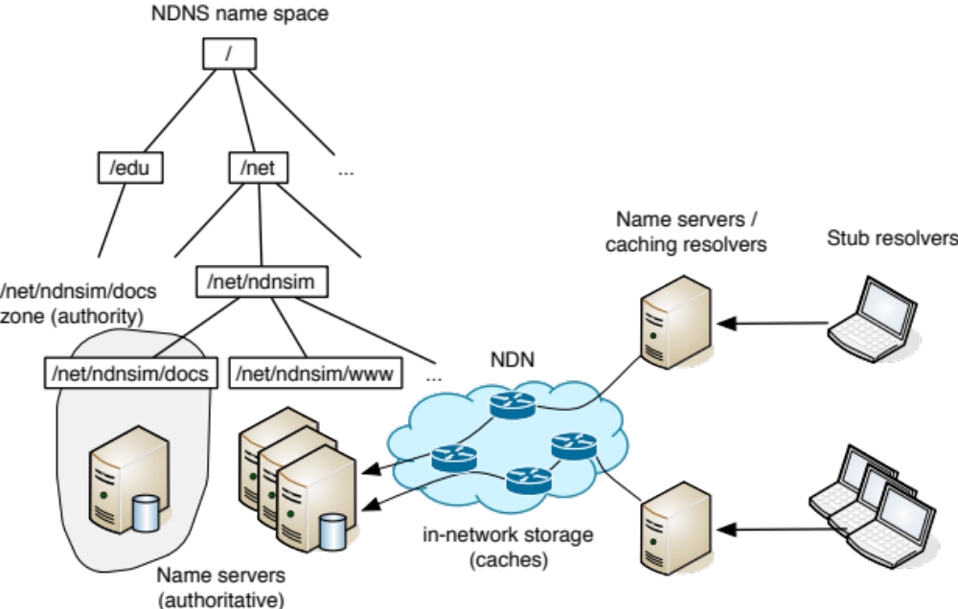
NDNS components
NDNS query protocol
NDNS (authoritative) name servers
NDNS resolvers
NDN network is not just delivery mechanism, but essential part of any NDN application
app-network cooperation
in-network storage

Slide 13
NDNS (authoritative) name servers
Playing the same role as in DNS
Different zone data management
  zone is a collection of RR sets = NDN Data packets
    NDN secures every Data packet
      crypto-signatures should be done in advance
      signatures “seal” RR set
  instead of AXFR-type zone transfers use data-centric synchronization primitives
    make use of build-in multicast capability of NDN
Notes:
few words about benefits of ChronoSync

Slide 14
Changes with iterative queries in NDNS
Iterative query (Interest) requests/fetches RR set
  RR set = NDN Data packet
Only the requested Data can be returned
  explicit question to discover delegation
    not all Data names can be globally reachable
  To fetch data about /net/ndnsim/www, must first find if
    /net is delegate, then if
    /net/ndnsim is delegated, then if
    /net/ndnsim/www is delegated
    ...
  The final answer belongs to lowest-level domain zone
NDNS iterative query = Interest for the specific RR sets in the specific zone
Data is returned to the requester using pending interest states on routers: name of Data must match name of the Interest (longest prefix match)
Notes:
(cannot return referrals, unless explicitly requested – talk about this, no need to be written on slide)
----- Meeting Notes (9/16/13 14:43) -----
referrals belong to zone
what is NS, what is "delegated"

Slide 15
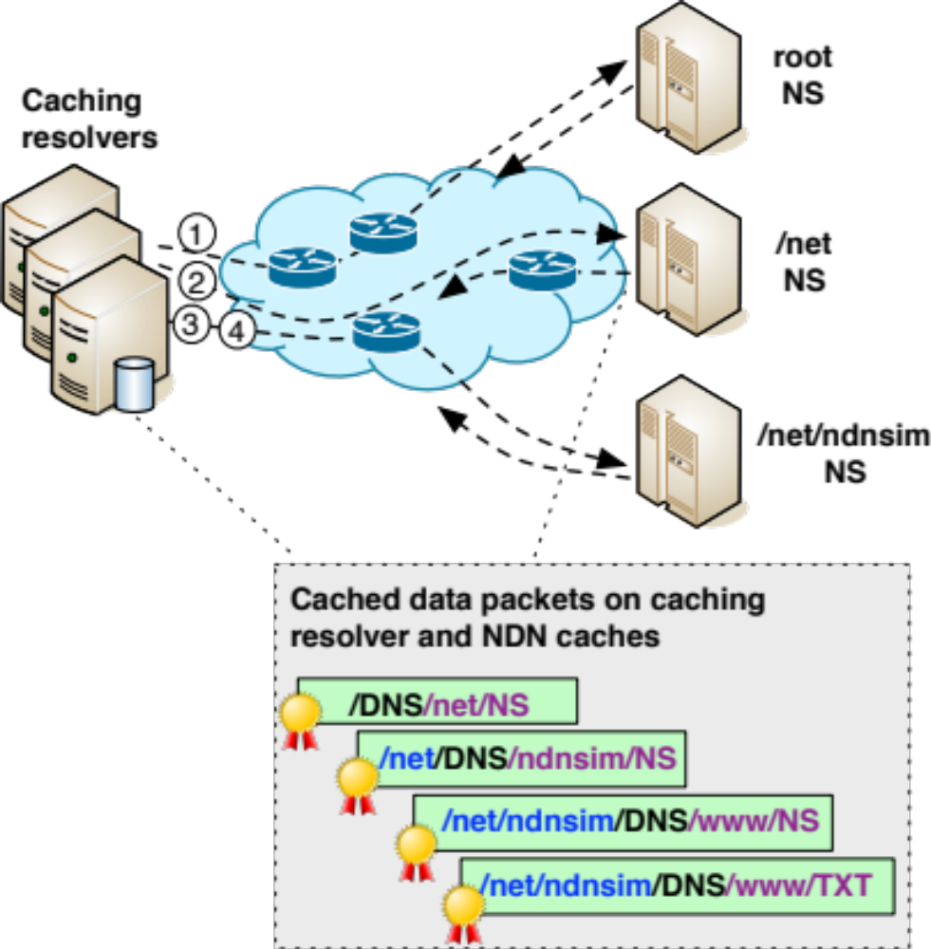
NDNS example: iterative query
Check with root zone if net delegated
Check with .net zone if ndnsim.net delegated
Check with ndnsim.net zone if www.ndnsim.net delegated
Authority found, ask the final question
Iterative responses are cached by the caching resolver and within NDN network
Notes:
----- Meeting Notes (9/16/13 14:43) -----
no parallel

Slide 16
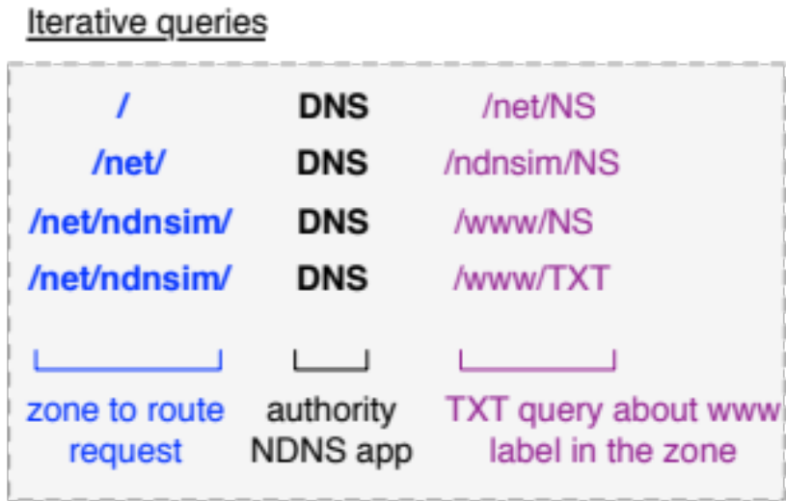
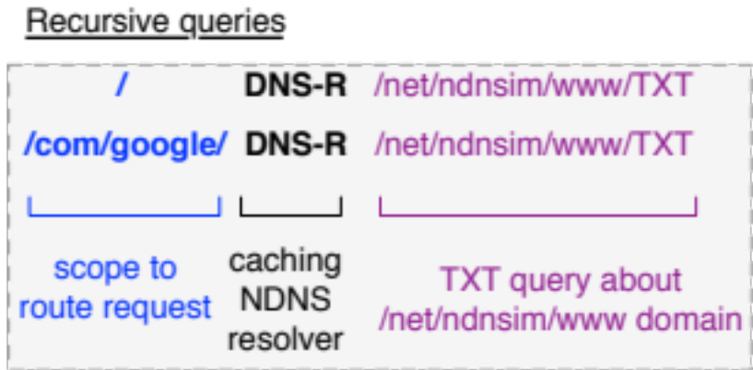
NDNS naming conventions
NDN the same for
  application
  transport
  network layers
NDN names should be expressive to provide functions for all layers
3-tier structure of NDNS names
  for network layer
    routable prefix
  for transport layer
    application de-multiplexor (demux)
  for application layer
    application-specific data descriptor (query)
Notes:
assumption about the routing
----- Meeting Notes (9/16/13 14:15) -----
extra slash
----- Meeting Notes (9/16/13 14:43) -----
NDNS naming conventions

Slide 17
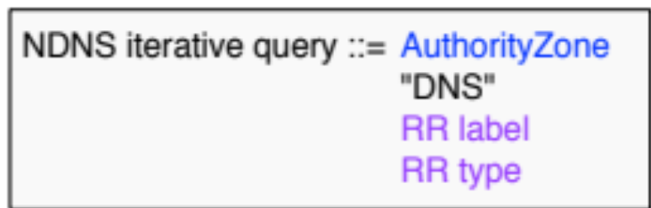
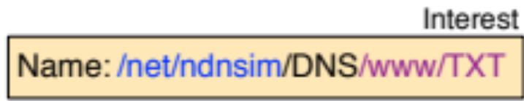
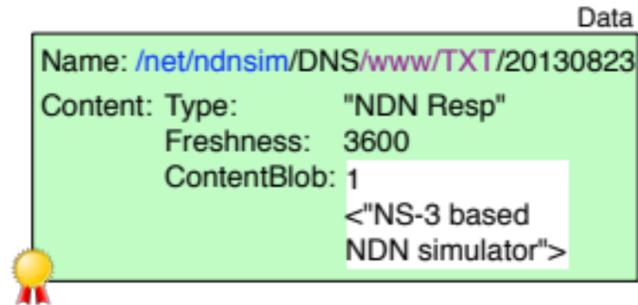
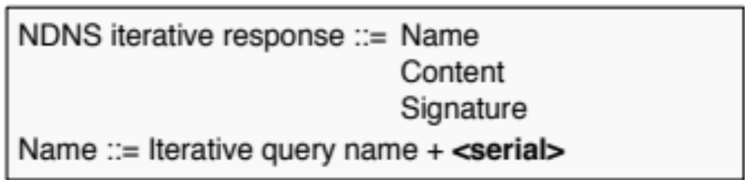
NDNS iterative query
Zone that Data belongs to
“DNS” application de-multiplexor
Specific question for zone’s data
<serial> is a "version" of a specific RR set
  a rough equivalent of zone's serial number, but with RR set granularity
signature

Slide 18
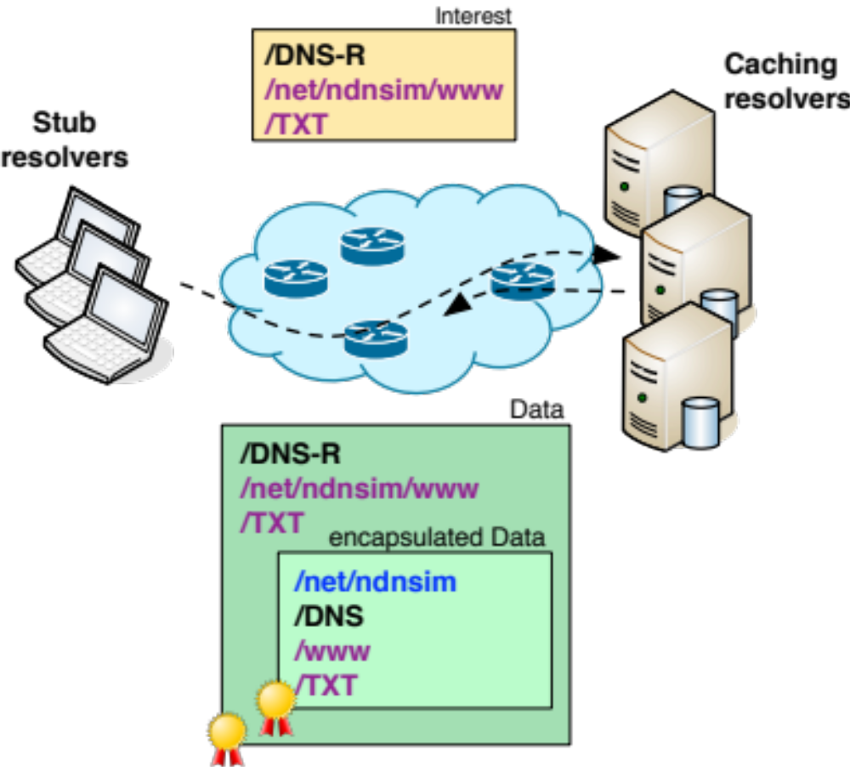
Recursive query example
Request recursive query data for
  /net/ndnsim/www domain
  TXT type
Caching resolvers supply data for recursive query
Caching resolver performs iterative query
  discovers authority
  get the answer and encapsulates
Process encapsulated iterative response Data
  verify outer and/or
  internal signature
Notes:
----- Meeting Notes (9/16/13 14:43) -----
may be introduce recursive query at some point

Slide 19
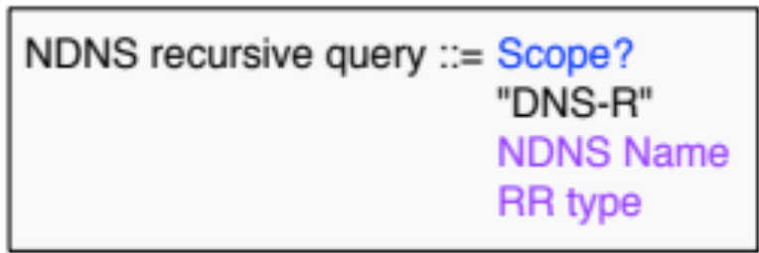

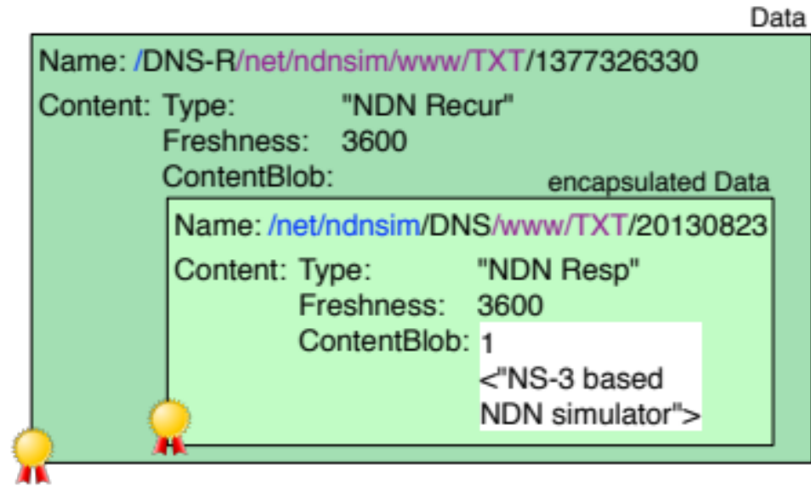
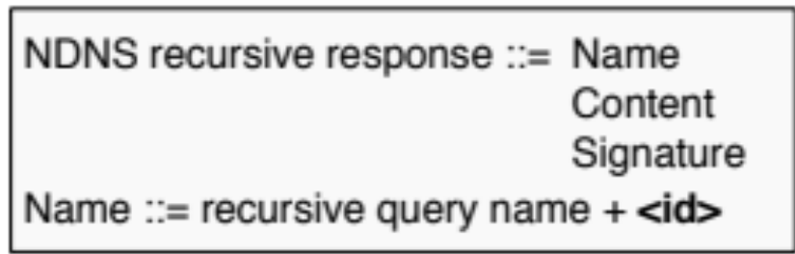
NDNS recursive query
“root” scope = local routers know how to get Data for “DNS-R” app
Double-secured response
  outer signed by caching resolver
  inner signed by the authoritative name server
<id> ensures uniqueness of the NDN Data packet name
  a timestamp value
whom to trust depends on trust relationships
Notes:
----- Meeting Notes (9/16/13 14:43) -----
id thingies
highligh "dns-r"

Slide 20
NDNS Security

Slide 21
Security of NDNS
NDNS is NDN applications
  security is build-in into the architecture
DNS is secured by DNSSEC extension
NDNS directly provides DNSSEC-equivalent trust model and security
Notes:
say this: just like DNS is an application in today’s Internet

Slide 22
Security properties inherited from NDN
Existing reflector DDoS attacks are not possible
  NDN does not have source addresses in packets
  Data is always returned to the requester
Existing direct DDoS attacks not possible
  For each name, only the first request reaches the server
    the rest will pull data out of cache
  DDoS by asking for different name can be easily mitigated
    per-packet state
    matched Interest-Data two-way traffic

Slide 23
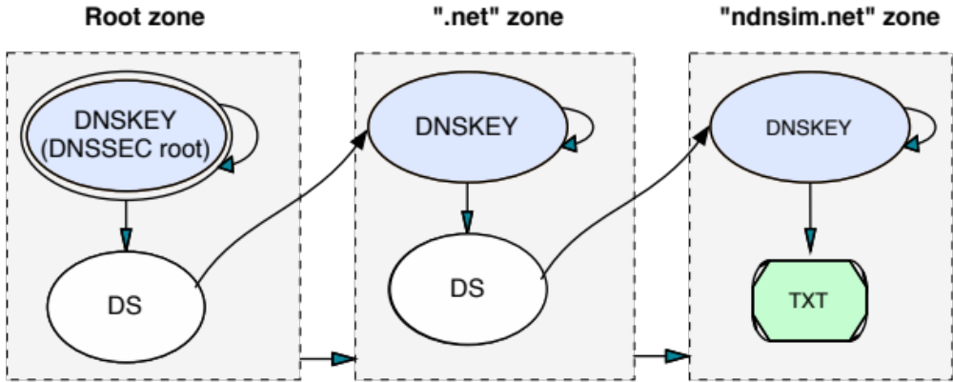
DNSSEC security model example
Each RR set is signed
  signature stored in RRSIG record
  key stored in DNSKEY record
DS record is used to authorize delegation
  hash of child zone’s DNSKEY

Slide 24
Similarities and differences between DNSSEC and NDN trust model
DNSSEC
each RR set is bundled with RRSIG
each DNS message can contain multiple [RRset, RRSIG]
RRSIG “specifies/hints” DNSKEY RR set used to produce signature using “Key tag”
DNSKEY RRset is signed by another DNSKEY or self-signed
Key is authorized by parent’s zone using DS record
NDN
each Data packet is bundled with a Signature and KeyLocator
each Data packet contains exactly one RR set
NDN’s KeyLocator refers to the unique key-certificate name used to sign data packet
Keys-certificates are also Data packets, thus can be further signed
Key-certificate is authorized via a proper signing chain
Notes:
----- Meeting Notes (9/16/13 14:43) -----
reformat

Slide 25
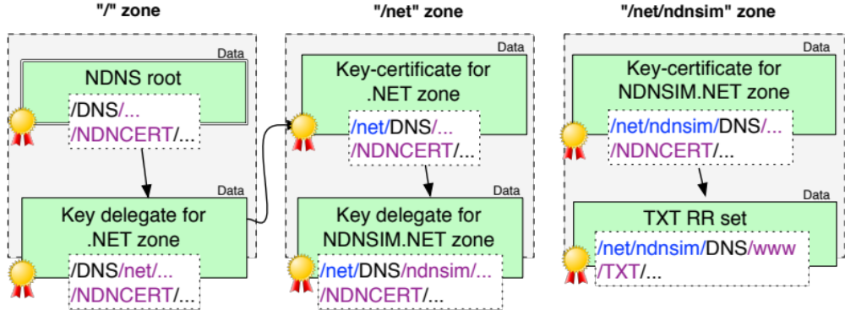
NDNS security model
NDNCERT for security delegation and record signing
No need for DS (Delegated Signer) record
  DNSSEC is DNS extension and is optional
  NDNS mandates security
  DS and DNSKEY distinguish authority over data
  NDNS use name to distinguish authority
Both keys for .net, but managed by different authorities

Slide 26
Evaluations

Slide 27
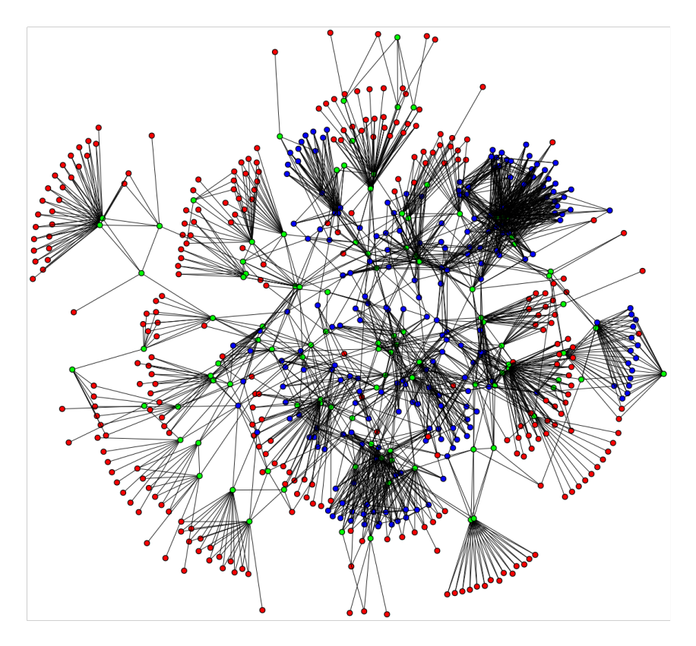
Simulation-based evaluation of NDNS
Real python-based prototype implementation
  the same code is running on the testbed and within the simulator
Based on the developed ndnSIM simulator
Using AT&T-based topology (Rocketfuel project)
  625 nodes, 2101 links
  296 “clients”, 108 “gateways” and “221” backbone

Slide 28
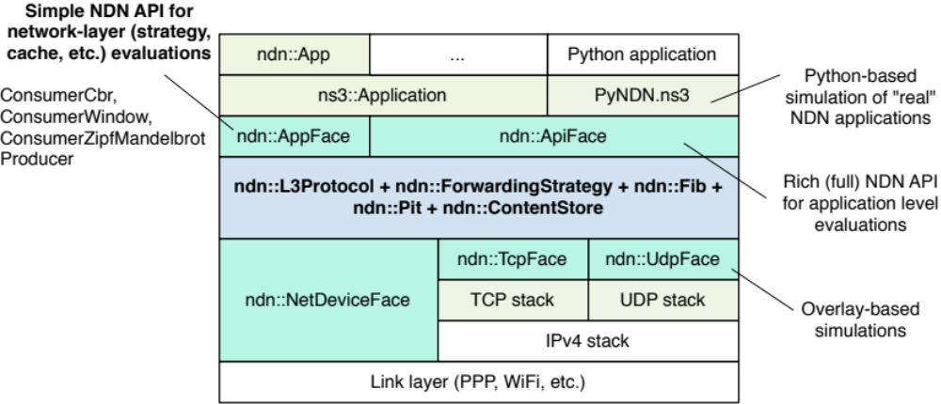
ndnSIM: another piece of contribution
Based on NS-3 network simulator
Has modular architecture and easily extended

Slide 29
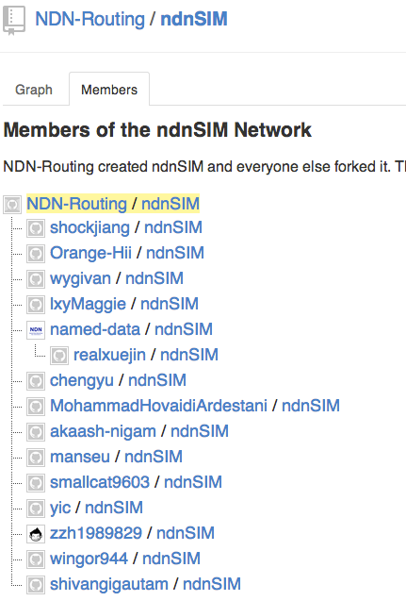
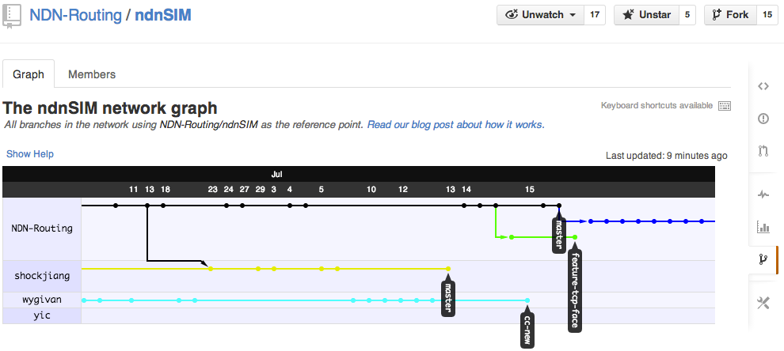
Current ndnSIM status
17 public forks on github
Active development
  new features
  extended API
  usage examples and documentation
A lot of activity on the mailing list

Slide 30
ndnSIM usage scope trends
(based on published papers and mailing list data)
http://ndnsim.net/ndnsim-research-papers.html#research-papers-that-use-ndnsim
  at least 17 published papers (by the early adopters, excluding us) use ndnSIM
Caching-related evaluation
  various caching replacement policies, collaborative caching
Congestion control related
  TCP-like transfers (end-to-end, host-by-host)
  queueing
Mobile and vehicular environment evaluations
DDoS-related evaluations
  interest flooding (us)
  content poisoning
Forwarding strategy experimentation (us)
  behavior in the presence of link failures, prefix black-holing
Application-level evaluations (us)
  exploration of ChronoSync protocol design
  NDNS evaluation in this thesis

Slide 31
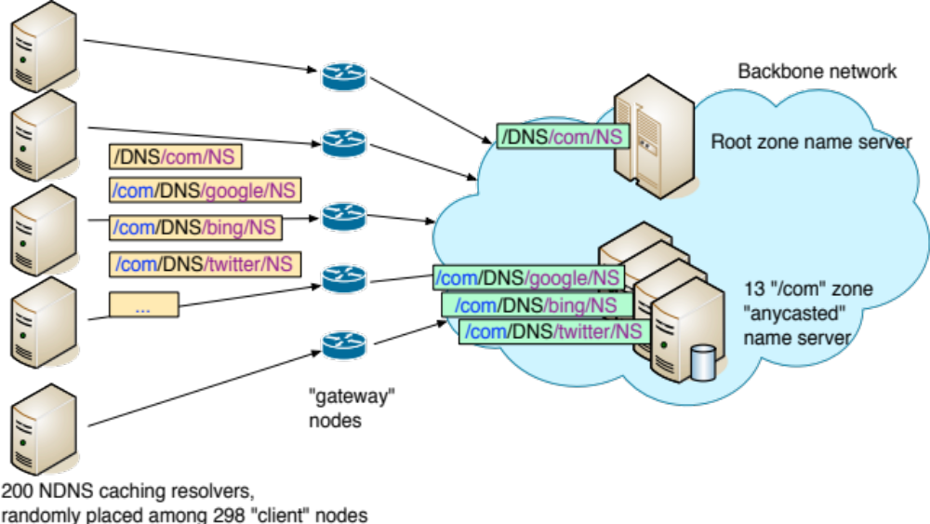
Simulation setup
Trace-driven:
  1 million queries to .com zone from large ISP
Objective
  check the degree of help from the NDN in-network caches
We did not evaluate application level-cache, assuming it is unlimited
No other traffic in the simulated network

Slide 32
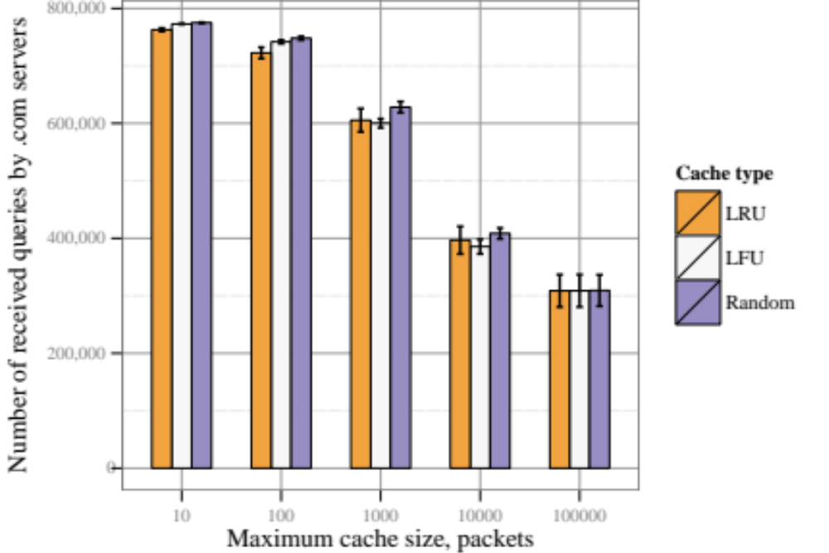
Number of queries that reached authoritative name servers
Baseline: total number of Interests out of caching resolvers (after app-caches)
Notes:
----- Meeting Notes (9/16/13 14:43) -----
why cache misses when 100% of cache

Slide 33
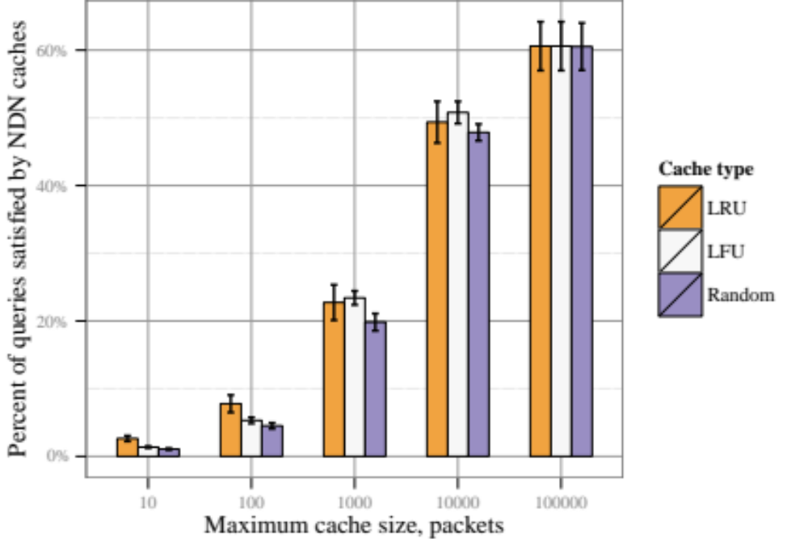
Relative impact of NDN caches: percent of queries satisfied from NDN caches

Slide 34
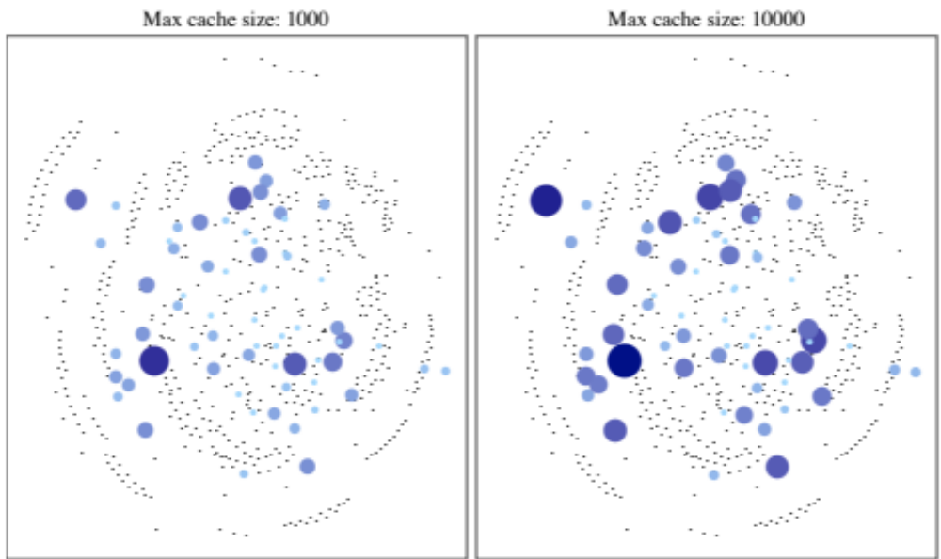
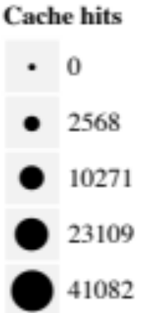
Cache hits of in-network NDN caches
Using in-network NDN caches allows sharing of iterative queries

Slide 35
Addressing NDN operational challenges with NDNS
Part 2

Slide 36
Security credential management

Slide 37
Security credentials storage for NDN applications
NDN builds security directly into data delivery
  Data packets must be signed
  KeyLocators specified in Data packets
Two open issues
  NDN does not specify how and where to store key-certificates
  Key-certificate revocation: remains a challenge
NDNS provides a solution to these issues

Slide 38
Security credential management on NDN
Initial attempt to deploy security credential on NDN testbed uses “repo” element
  in-network permanent storage
  can store any Data packet
  But
    repo is not authoritative source for Data (cannot say “NO”)
    current implementation is limited
NDNS
  general-purpose secure distributed storage
  application can define any custom RR type to store in NDNS
  authoritative source for Data
    authoritative NDNS name servers have full “authority” over the zone
    if RR does not exist in the zone, NDNS will vouch for that

Slide 39
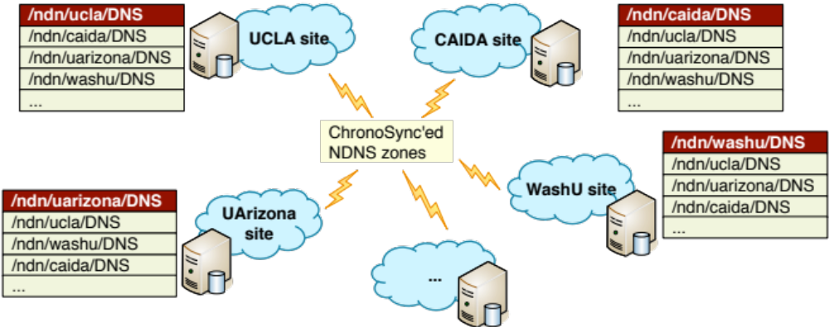
Using NDNS to store key-certificate
Key-certificate can be fetched by name
  From where? From NDNS
Each NDN site run NDNS server
  primary for the site’s zone
  secondary for other site’s zone

Slide 40
Key-certificate revocation with NDNS
Crypto credentials (key-certificates) need to be revocable
  by certificate issuer
  by key owner
Mechanisms
  Revocation lists and online certification checks
  Physically removing key-certificate
    invalid key-certificate should be removed from NDN network
All of these supported by NDNS
  NDNS can be a revocation list/lookup service
    issue/owner can have they own (implicit) lists
  Any NDNS record can be removed
    owner (= delegated zone) can revoke (delete) individual records
    issuer (= parent) can revoke (delete) delegation record
    takes effect after TTL/freshness period
Notes:
like spam blocking list

Slide 41
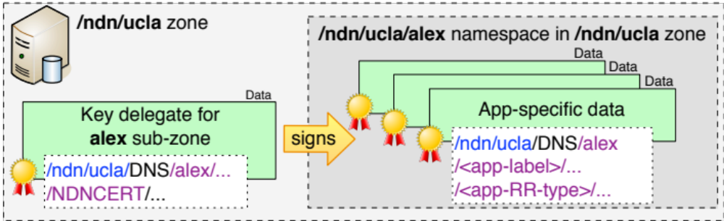
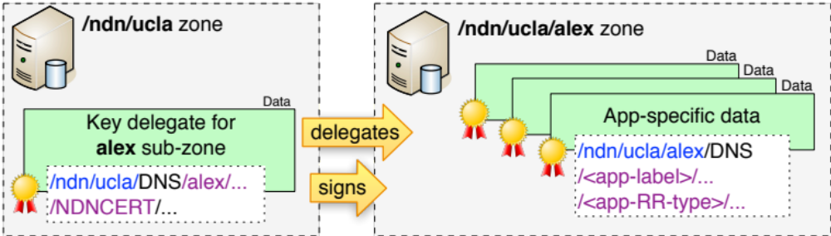
NDNS storage options for users
Site provides storage for user’s data
User uses its own persistent storage
Notes:
A user can delegate subzones for different applications/usage
----- Meeting Notes (9/16/13 14:15) -----
title is odd

Slide 42
Routing scalability

Slide 43
Scale Interest forwarding
NDN forwards Interest by data names
  Number of application names virtually infinite
    over 200 million just 2nd-level DNS names
Solution: map-n-encap
  proposed many years back to scale IP routing
    globally routable and non-routable addresses
    DNS to map
    IP-IP encapsulation to forward packets
User Networks
    S. Deering. “The Map & Encap Scheme for scalable IPv4 routing with portable site prefixes.” Presentation Xerox PARC, 1996.
    M. O’Dell. “8+8—An alternate addressing architecture for IPv6.” Internet draft (draft-odell-8+8-00), 1996.
    D. Farinacci. “Locator/ID separation protocol (LISP).” Internet draft (draft-farinacci-lisp-00), 2007.
    R. Atkinson, S. Bhatti, and S. Hailes. “ILNP: mobility, multi-homing, localized addressing and security through naming.” Telecommunication Systems, 42(3), 2009.
encapsulation
Transit networks
Notes:
----- Meeting Notes (9/11/13 16:24) -----
forwarding alias

Slide 44
Routing scalability in NDN
All NDN names are applications names
  some names are directly routable world-wide (DFZ)
  other names are routable just only inside ISP networks
Globally routable names
  large ISPs
    /telia, /cenic
  large content providers
    /com/google; /com/cnn; /com/wikipedia
  large organizations
    /edu/ucla; /edu/caida
Locally routable only
  local communication only
    /localnet/...
  for global communication
    /net/ndnsim; /com/lynch; /org/gnu
    applications “registers” prefix within ISP

Slide 45
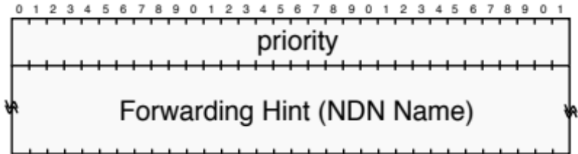
Forwarding hint
Interest name “uniquely” identifies the requested Data
  but routers may not known where the Data is or could be
Solution: add “Forwarding Hint” to the Interest packet
  an NDN name, known to be routable within DFZ
  routers can ignore hint, if they know other ways to satisfy Interest
    local Data producer
    already in local cache
NDNS as FH storage/lookup service
  similar to ILNP effort [1]
  new “FH” RR
    priority can be used to define Data producer policy on which hint is “preferred”
Interest packet
Name
ForwardingHint
Selectors (opt)
Nonce
    [1] http://ilnp.cs.st-andrews.ac.uk/

Slide 46
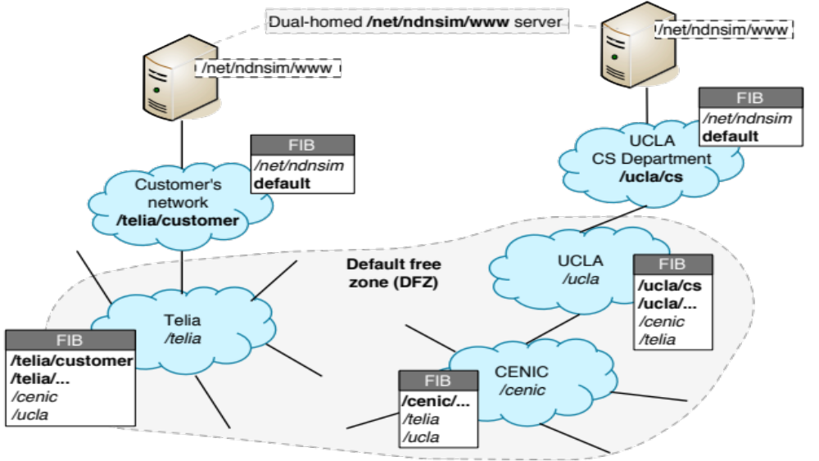
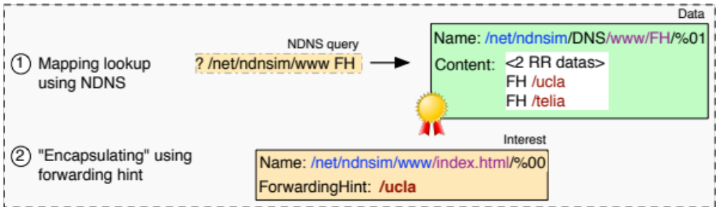
Example of map-n-encap world for NDN

Slide 47
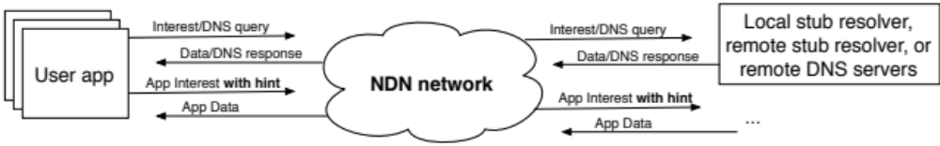
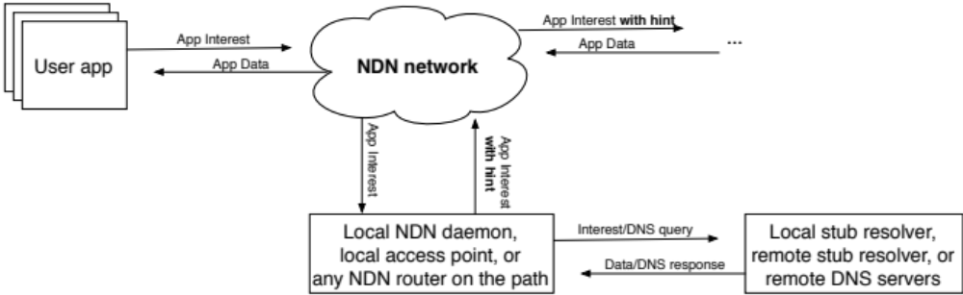
Forwarding hint lookup options
Consumer-based lookup
Who does the lookup is still a research question
consumer may not know which names are not “routable”
Network-based lookup
Notes:
MobilityFirst and other for network-based lookups

Slide 48
Forwarding hint for mobility support
Network must be able to forward Interests to mobile producers
  Mobile producer updates its FH in NDNS
    TTL (Freshness) specifies basic granularity for the hint lifetime
  New consumers lookup NDNS to fetch data of mobile producers
    mobile producer can notify existing consumers about the hint changes directly (inside the returned Data packet)

Slide 49
Future work plan
Deploying NDNS within NDN testbed (and beyond)
Providing storage for security credentials of NDN testbed participants
Developing libraries to scale NDN communication globally using NDNS

Slide 50
Conclusions
Designed and prototyped NDNS to meet operational needs in NDN rollout
  provides storage for NDN security credentials
  provides a mapping service to scale NDN name-based routing
  and more
NDNS is among the first attempts to “port” existing Internet infrastructure system onto NDN
  one could imitate IP in NDN, but it would be inefficient
  naming considerations dominates design of NDN applications
  NDN’s build-in security proves useful and simplifies overall design
Notes:
----- Meeting Notes (9/16/13 14:15) -----
no p2p
naming - simplify, dnssec

Slide 51
Questions

Slide 52

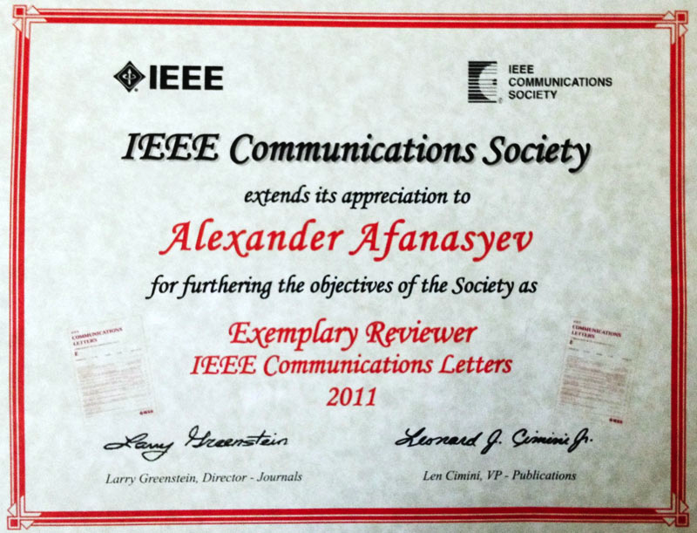

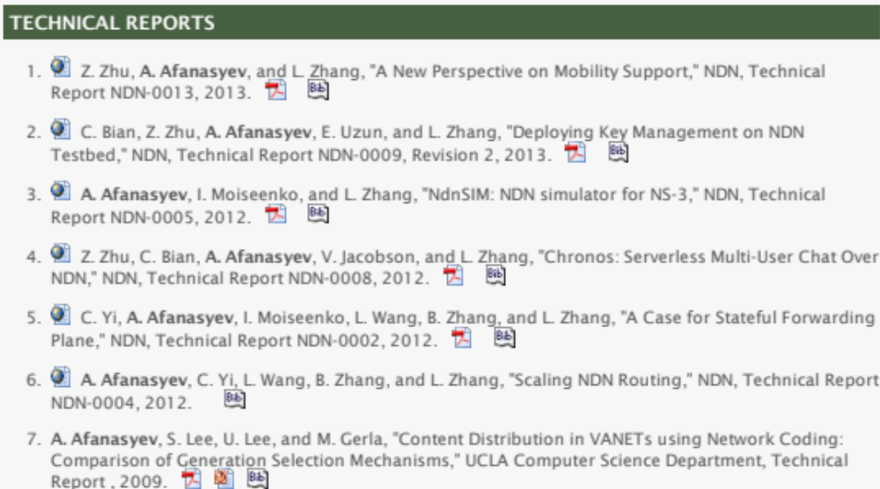
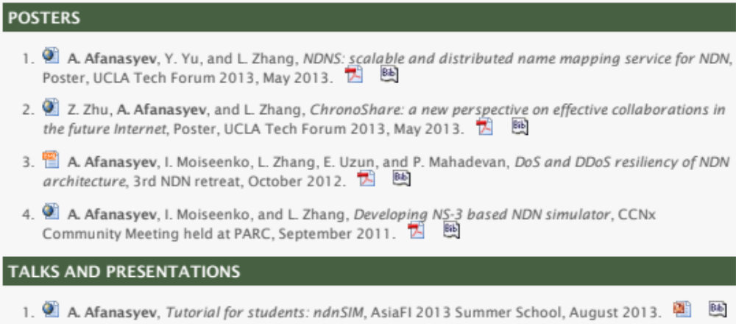
List of publications

Slide 53
NDNS security
Cryptography
  signature of the Data packet matches the public key
Application-specific name-based policy
    the specified key-certificate is authorized to certify Data
      key-certificate is the trust anchor
      name of Data and name of key-certificate match the policy rule

Slide 54
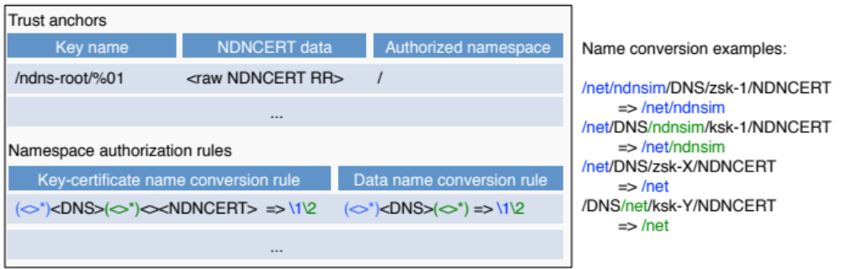
NDNS security policy (“identity” policy)
Policy encoded into the NDNS applications
List of trust anchors
  anchors can have limited scope (unlike current CAs)
List of name reduction rules, e.g., using NDN regular expressions
  key-certificate name to namespace
  data name to namespace
  OK only if data namespace covered by the key-certificate namespace
Notes:
may be keep talking about it. not sure yet

Slide 55
DyNDNS as remote database update protocol
NDNS is thought to be used as a general-purpose database
  query operation is important, but not enough
  need efficient protocol(s) for update and data removal
    support “sporadic” updates
    support “bulk” updates
    ensure eventual synchronization
DyNDNS protocol for updates
  similar to dynamic updates in DNS
  update granularity: RR set
    the updater is responsible to form correct RR set Data packet, if only one RR data is modified
    “empty” Data to delete RR set
  build-in NDN security, exactly the same way as NDNS itself

Slide 56
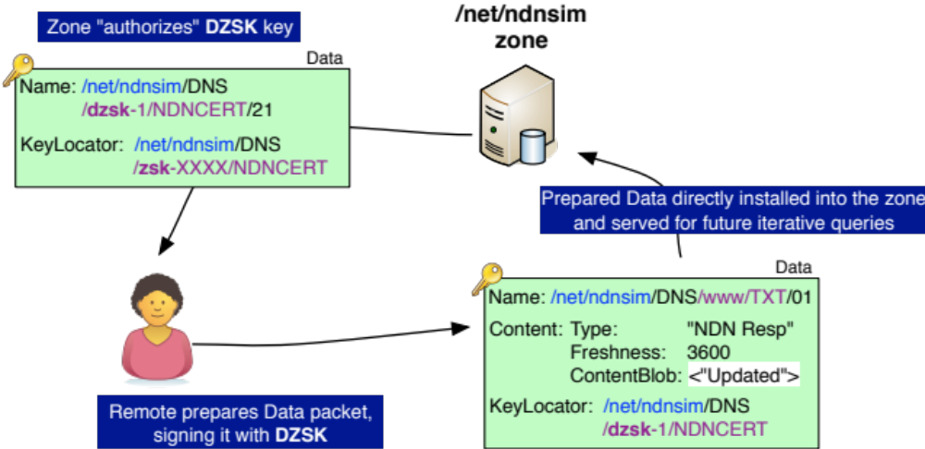
DyNDNS cycle

Slide 57
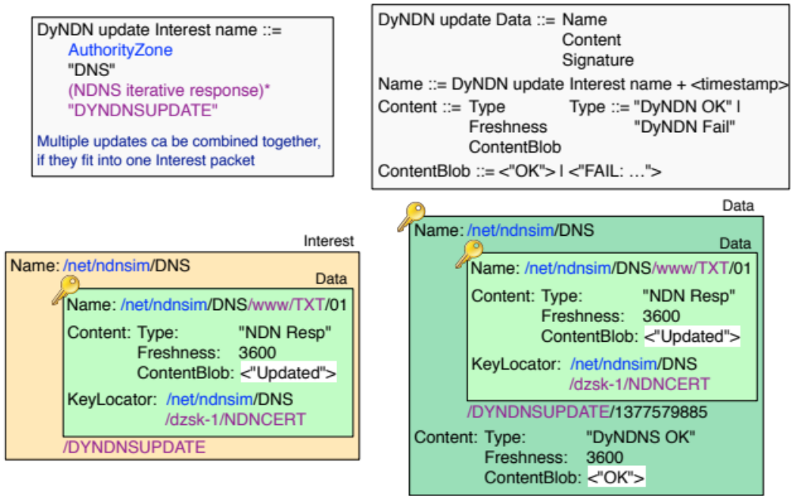
Definition of singular DyNDNS updates
(Interest-based transport)

Slide 58
DyNDNS update overview
Updater side
  (optional) Lookup existing NDNS RR set
  Create new Data packet with new RR set data
    empty RR set data if RR set needs to be deleted
  Sequence number for the created RR set Data packet should be larger than any previously used
    current timestamp can be used
  Sign Data packet with DZSK and deliver to authoritative name server
Authoritative name server side
  (does not matter master or secondary, since zone data is supposed to be synchronized)
  authorize update
    Check if Data packet satisfies NDNS security policy
    Check NDNCERTSEQ record that corresponds to DZSK (the same label)
      if record does not exist, authorize Data and create NDNCERTSEQ record with the sequence number from Data packet
      if record exist, authorize Data if record is “less” than sequence number in Data, and update NDNCERTSEQ record
  install (replace) Data packet to the zone synchronize with others, if necessary
  this effectively prevents any replay attack

Slide 59
DyNDNS bulk updates
The updater can simply become a temporary NDNS secondary server and perform zone data synchronization
  for example, using ChronoSync
Updates are secured exactly the same way as sporadic updates
  the zone authorizes DZSK
  updated records are signed by DZSK
  the zone keeps track of DZSK usage in NDNCERTSEQ RR, as to prevent potential replays

Slide 60
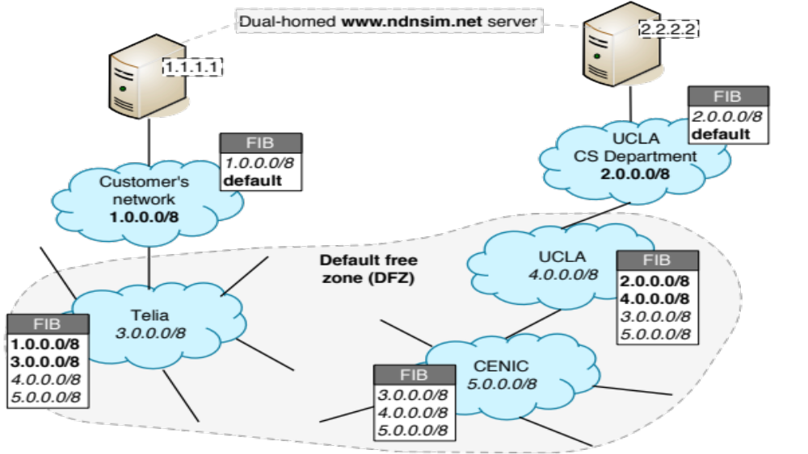
Example of map-n-encap world for the IP Internet

Slide 61
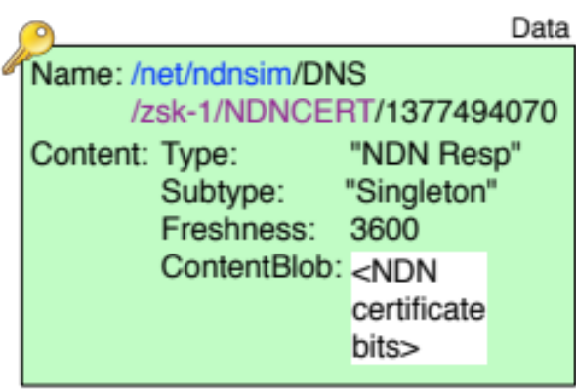
Singleton RR types
Contains exactly one RR data
Data packet has special format
  special NDN packet Subtype
  implicit number of RR data (1)
  application-specific format for ContentBlob
Simplifies NDNS security design
  KeyLocator needs to point to unique key-certificate Data packet using NDNS query
  NDNS query (= NDN interest) uniquely identifies RR set
Key-certificate Data packets stored in singleton NDNCERT RR sets
  NDNCERT RR set use unique label
    zsk-<id> zsk-123213312
    ksk-<id> ksk-0
    dzsk-<id> dzsk-mobile-1
  KeyLocator can include explicit iterative query name
  we still be “querying” for DNS RRset, but we will be getting what we actually asking for
Singleton RR types bring power and flexibility to NDNS
  Can be used not only for security purposes, but for any other application-specific data
(optional) prefix explicitly specifies usage of the key, postfix provides uniqueness for RR set

